Slide 1
LIVE in your classroom!
Presented by
The Amazing Pina Viscomi &
The Equally-Amazing Ryan Vickers

Slide 2
Outline
Game introduction
History
Why play the game?
Curriculum Links
Basic rules
Game
Wrap up
Questions and Answers

Slide 3
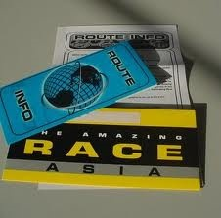
Idea of the game
The object of The Amazing Race: LIVE in your classroom is for teams of 2-4 players to complete a series of clues and be the first team to return to the “Finish Line”.
Depending on your wants/needs you can also add in challenges such as “Roadblocks” that students can perform along the way – these can be physical, academic, or logical.

Slide 4
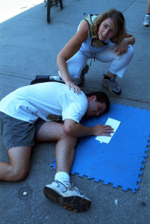
How did this come about?
In 2005, we participated in an event in Toronto that had its origins in the CBS adventure show The Amazing Race. We saw the potential for adaptation to a school setting and it took off from there!

Slide 5
Why do The Amazing Race?
Experiential Learning
Students apply their language skills outside the classroom.
Students have fun while learning.
21st Century Skills
Students are challenged to use creativity, critical thinking, communication and collaboration.
Students use technology they are comfortable with.
Differentiated Instruction
Different learning styles are met.

Slide 6
Why do The Amazing Race?
Collaborative Inquiry
Students learn and practice important collaboration skills.
Opportunity for leadership development.
Community
This format allows students to explore more closely your school, and, depending on flexibility, the community around your school.

Slide 7
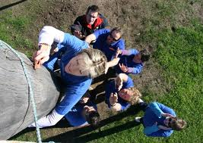
Curriculum Links: How does it adapt?
This is taken directly from the ministry’s links for FSF1D, only as an example.
use appropriate language conventions during oral communication activities.
read and demonstrate an understanding of a variety of simple texts.
use appropriate language conventions in their written work.

Slide 8
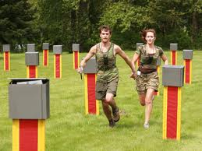
Today’s Basic Rules
You can’t break any laws or school rules.
You must stay together as a team at all times.
The boundaries for today’s race are the school and its outside grounds. No clues will be outside the school grounds.
You can use any resources to figure out clues EXCEPT other teams.
If you haven’t found the finish line by 3:15, please return immediately to this room.

Slide 9
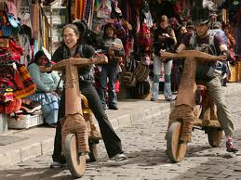
Communication of your clues
Please text your team name, the colour of the clue that you’re answering, and your answer – ie. “ALPHA RED TOOTHPASTE”. You’ll then receive a message with your next clue colour or a message to try again.
You can text us for help… but each location we give you is a 5 minute penalty and each answer to a clue we give you is a 5 minute penalty. Choose wisely!

Slide 10
The clues
Each clue is assigned a colour. It will be a small riddle/puzzle to solve. Find the location, find out the answer, and then text back the answer.
PLEASE DO NOT OPEN CLUES UNTIL INSTRUCTED. One clue is a “dud” – opening that clue or not bringing it back with you sealed incurs a 15 minute penalty!

Slide 11
Example Clue
Go to the room that is 2⁷, once there, find out where all the kids will hang out on Friday, October 20th, 2011.
Room = 128
Answer = Dance Party
(listed on a poster)

Slide 12
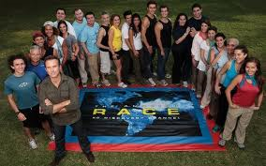
How do we determine placement?
The winning team is determined by arrival at the finish line (plus applicable penalties). If no one finishes, the team that arrives back to this classroom with the most complete clues (plus applicable penalties) wins.

Slide 13
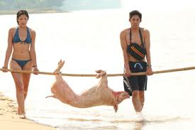
Let’s break into teams!
You will each receive a package containing the following:
Eight clues sealed in envelopes.
A “Start” envelope – this will contain the colour of your first clue and a reminder of how to text us your answers.
A snack in case you get hungry.
You also need to make sure to have someone in your team with a cell phone.

Slide 14
GOOD LUCK AND TRAVEL SAFE!!!

Slide 15
The winners!

Slide 16
What we did while you were out… (aka the control centre)

Slide 17
Frequently Asked Questions
I don’t have access to a cell phone/I don’t want to give out my number. What should I do?
Students can phone in to the school number
You can use Walkie Talkies
You can assign a team member as a runner
You can use volunteers at each clue location
You can set up the game where each team has a specific route to follow

Slide 18
Frequently Asked Questions
I want to play my game outside of my school grounds. How do you suggest I do this?
Make sure to check with your administration that this is okay to do.
We sent a letter home advising parents.
Make sure that you have clearly established boundaries and that parents know that students are leaving school grounds.

Slide 19
Questions & Answers

Slide 20
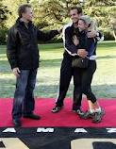
Thank you for running The Amazing Race
And no, you can not have the mat!

